Slide 1

Hello there. this presentation is about programming, specifically: what is compiler and what's the difference between compiled and interpered languages

Slide 2
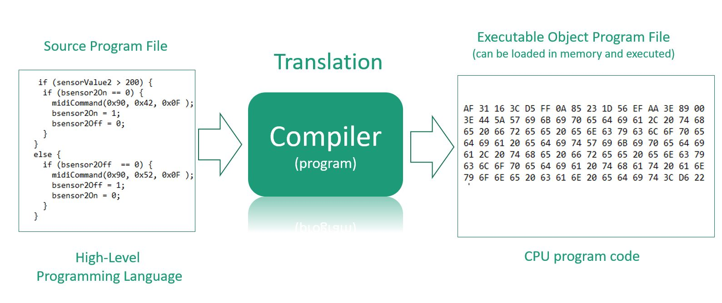
Compiler
Every programming language has it's own compiler. compiler is basically a translator between programmer and a computer, it translates programming language into binary language, which computer can understand.

Slide 3
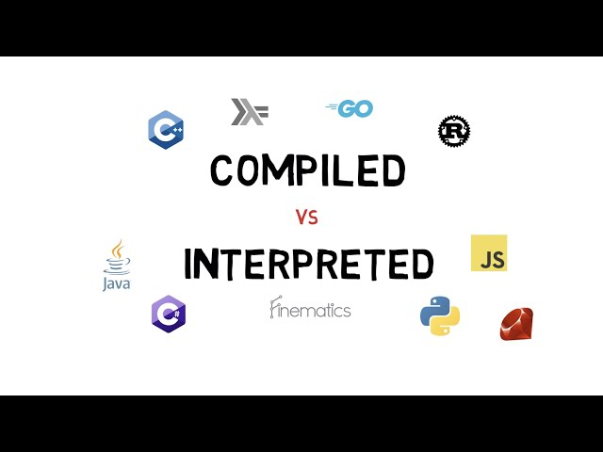
The difference between compiled and interpreted languages
The difference between compiled and interpreted languages is that interpreted language's "compiler", "interpreter", translates commands line by line and then sends it to the computer, unlike compiled language's compiler which translates whole thing at once and then sends it to the computer

